Slide 1
created by : ashutosh gupta m. gangadharappa
Image Retrieval Based on Colour, Shape and Texture

Slide 2
INTRODUCTION
CBIR can be also be helpful to the users who don’t know about the name of something, they can simply click the image and search it and simply get the information about it without any much effort.
In CBIR, the features are extracted from the image in respect of their color, shape and texture, and then these features are helpful in comparison. The more accurate the features are the more precise we are going to get the results.

Slide 3
The three features are color, shape and texture. Information Retrieval is the process of converting a request for the information into a meaningful set of references. The conventional techniques were purely based on the text features.
The main CBIR system performs two major functions. First, the feature extraction in which the features like texture, shape, color etc are extracted. Second, there is similarity measurement techniques which measures the deviation of the query image from the images present in the database.

Slide 4
Color Auto Correlogram
The technique we are using in this CBIR system is color auto correlogram. The description of this feature lies upon the fact that it defines the spatial correlation of colors.
The color correlogram predicts the probability of finding a pixel of color at a specified distance from a color of pixel in the image.

Slide 5

Texture : Block Difference of Inverse Probabilities
Texture feature is used to define the smoothness, coarseness and regularity of the image. Texture is an important feature to describe the surface and the structure of the image.
The image is divided in the combination or in the group of four blocks. The calculation of the formula is being done on these blocks separately and then they are placed in the write order to form the image.
$$BDIP= M^{2}− \frac{\sum_{(i,j)εB}{I(i,j)}}{\max_{(i,j)∈B}I(i.j)}$$

Slide 6
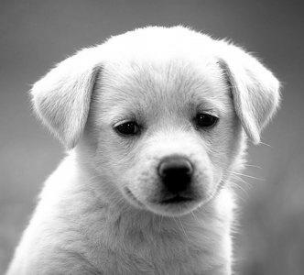
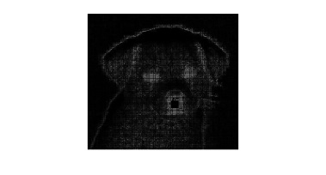

Slide 7
SHAPE
The shape feature is one of the most common and important feature used in Image Retrieval System. In this paper, we have used Sobel edge detection technique. Edge detection is one of the basic tools used in image processing, which aims for the detection of the points in the digital image where the brightness of the image changes sharply.

Slide 8
Sobel Operator
The Sobel Operator runs 2-D spatial gradient operation and finds out the high spatial frequency region which gives edges in that image. Normally it is helpful in finding approximate gradient magnitude at every point in the greyscale image. A 3X3 kernel is included in this operator. One kernel is simply the complementary of the adjacent kernel.

Slide 9
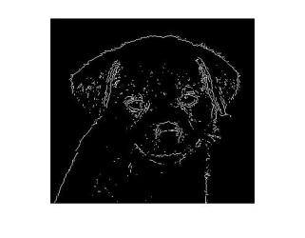

Slide 10

Similarity Measurement
Euclidean distance is used in this CBIR
$$E\left(a,b\right)=\sqrt{{\left(x1−x2\right)}^{2}+{\left(y1−y2\right)}^{2}}$$

Slide 11
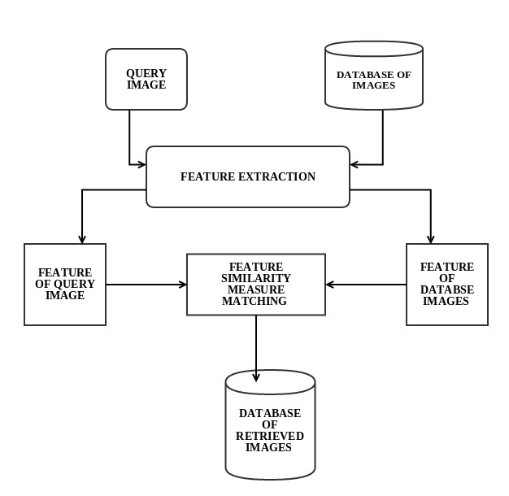
CBIR Model: Traditional

Slide 12
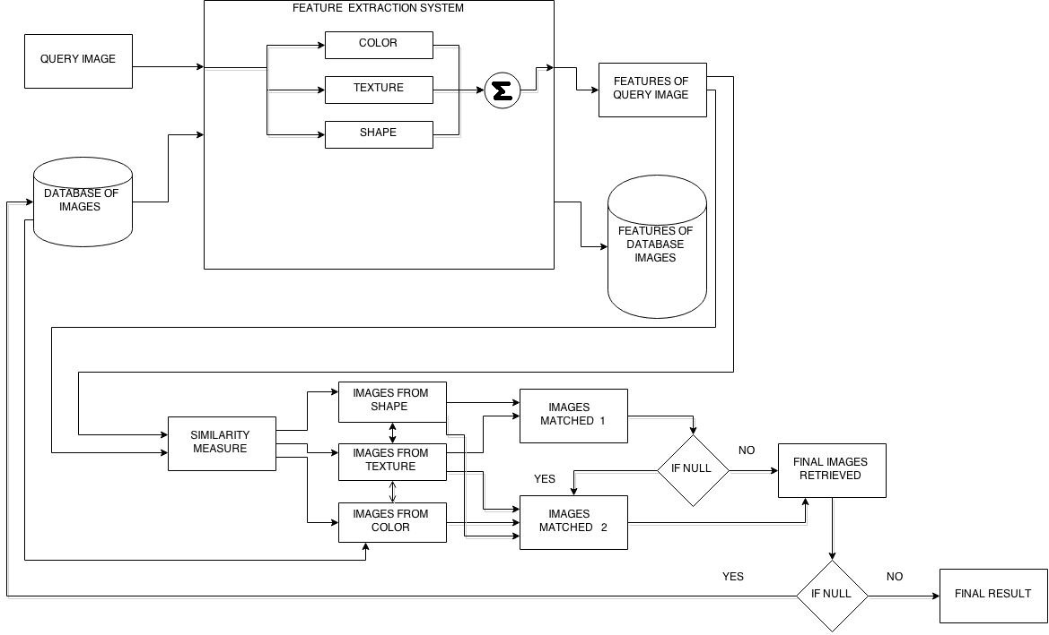
CBIR Model : Proposed

Slide 13
Results
Table for Color Correlogram
Color | Bus | Dinosaurs | Rose | Africa | Beach | Horse | Mountain | Elephant
Rose | 3.9111 | 4.8206 | 3.1260 | 3.4158 | 4.5306 | 3.5780 | 3.7757 | 3.9749
Bus | 3.0058 | 4.2277 | 4.0522 | 4.3279 | 4.0522 | 4.2277 | 3.7464 | 3.8034
Africa | 3.5883 | 3.7932 | 3.3019 | 2.4288 | 3.5992 | 2.5603 | 3.5647 | 3.0510
Beach | 4.4522 | 4.8013 | 4.0069 | 3.5984 | 3.5283 | 4.3949 | 4.1263 | 4.3354
Dinosaurs | 4.0412 | 2.7868 | 4.2457 | 3.3600 | 3.9261 | 3.6871 | 4.2666 | 4.4133
Mountain | 4.8872 | 5.3326 | 5.4185 | 4.3186 | 5.1002 | 4.4292 | 4.0145 | 4.2796
Horse | 3.3506 | 3.4115 | 3.6460 | 2.9362 | 3.1976 | 2.4088 | 3.7308 | 3.5972
Elephant | 4.9048 | 5.4747 | 4.6432 | 4.2840 | 4.3252 | 4.3934 | 3.9694 | 4.1661

Slide 14
Table for BDIP
Texture | Bus | Dinosaur | Rose | African | Beach | Horse | Mountain | Elephant
Rose | 1.6768 | 1.1965 | 1.0236 | 1.3929 | 1.4630 | 1.1418 | 1.4035 | 1.1962
Bus | 1.4164 | 1.6004 | 1.5167 | 1.6122 | 1.4968 | 1.5072 | 1.4265 | 1.6420
African | 1.5766 | 1.5449 | 1.3437 | 1.2900 | 1.5026 | 1.2042 | 1.3278 | 1.1898
Beach | 1.6236 | 1.1938 | 1.0060 | 1.2953 | 1.0382 | 1.3249 | 1.2819 | 1.0822
Dinosaurs | 1.6434 | 0.8403 | 1.0982 | 1.4772 | 1.4198 | 1.1499 | 1.3314 | 1.1465
Mountain | 1.5428 | 1.3781 | 1.2339 | 1.2806 | 1.2611 | 1.1943 | 1.1878 | 1.9937
Horse | 1.4916 | 1.2612 | 1.1385 | 1.1822 | 1.3562 | 0.9751 | 1.2067 | 1.0630
Elephant | 1.4500 | 1.1542 | 1.0594 | 1.1883 | 1.1611 | 1.0480 | 1.0911 | 0.8401

Slide 15
CONCLUSION
In our CBIR, the images which are not relevant to the query image are also coming up in the result domain. This error can be removed if the appropriate number techniques are used in the CBIR. This is just an attempt to create a CBIR which can give a certain range of accurate result. There are other techniques which are used to calculate texture, color as well as the shape feature. These techniques can also be used to determine the similar images present in the database

Slide 16
REFERENCES
Deepak S. Shete and Dr. M.S. Chavan, "Content Based Image Retrieval: Review",InternationalJournal of Emerging Technology and Advanced Engineering,ISSN 2250-2459, Volume 2, Issue 9, September 2012, pp 85-90.
H. V. Jagadish, "A retrieval technique for similar shapes," Proc. of Int. Conf. on Management of Data, SIGMOID’91, Denver, CO, pp. 208-217,
May 1991
ReshmaChaudhari, A. M. Patil "Content Based Image Retrieval Using Color and Shape Features", International Journal of Advanced Research in Electrical, Electronics and Instrumentation Engineering Vol. 1, Issue 5, November 2012, pp 386-392.
G. Pass, and R. Zabith, "Histogram refinement for content-based image retrieval," IEEE Workshop on Applications of Computer Vision, pp. 96-102, 1996.
Pentland, R. Picard, and S. Sclaroff "Photobook: Content-based manipulation of image databases" International Journal of Computer Vision, 18(3):233–254, 1996.
J. Huang, et al., "Image indexing using colorcorrelogram," IEEE Int. Conf. on Computer Vision and Pattern Recognition, pp. 762-768, Puerto Rico, June 1997.

Slide 17
Young Deok Chun, Sang Yong Seo, and Nam Chul Kim, "Image Retrieval Using BDIP and BVLC Moments", IEEE TRANSACTIONS ON CIRCUITS AND SYSTEMS FOR VIDEO TECHNOLOGY, VOL. 13, NO. 9, SEPTEMBER 2003, pp 951-957
S. Y. Seo, C. W. Lim, Y. D. Chun, and N. C. Kim, “Extraction of texture regions using region-based correlation,” in Proc. SPIE VCIP2001, vol. 4315, San Jose, CA, Jan. 2001, pp. 694–701
Kiranjeet Kaur, Sheenam Malhotra, "A Survey on Edge Detection Using Different Techniques", International Journal of Application or Innovation in Engineering & Management, Volume 2, Issue 4, April 2013,pp 496-500
N. Senthilkumaran and R. Rajesh, “Edge Detection Techniques for Image Segmentation - A Survey”, Proceedings of the International Conference on Managing Next Generation Software Applications (MNGSA-08), 2008, pp.749-760.
Nick Kanopoulos, et.al. ; “Design of an Image Edge Detection Filter using the Sobel Operator”, Journal of Solid State Circuits,IEEE, vol. 23, Issue: 2, pp. 358-367, April 1988.
G.T. Shrivakshan, DrC. Chandrasekar, “A Comparison of various Edge Detection Techniques used in Image Processing” IJCSI International Journal of Computer Science Issues, Vol. 9, Issue 5, No 1, September 2012

Slide 18
R.Jayakumar, B.Suresh “A REVIEW ON EDGE DETECTION METHODS AND TECHNIQUES” IJARCCE vol. 3, Issue 4, April 2014
B. G. Park, K. M. Lee, and S. U. Lee, “Color-based image retrieval using perceptually modified Hausdorffdistance,”Journal on Image and Video Processing, vol. 2008, pp. 1–10, 2008.
J. Hafner, H. Sawhney, W. Equitz, M. Flickner, and W. Niblack, "Efficient Color Histogram Indexing for Quadratic Form Distance Functions", IEEE ^{Transactions} on Pattern Analysis and Machine Intelligence, vol. 17, no. 7, pp. 729-736, 1995.
http://wang.ist.psu.edu/docs/related/

Slide 19
THANK YOU

